Slide 1
Variables & Constants

Slide 2
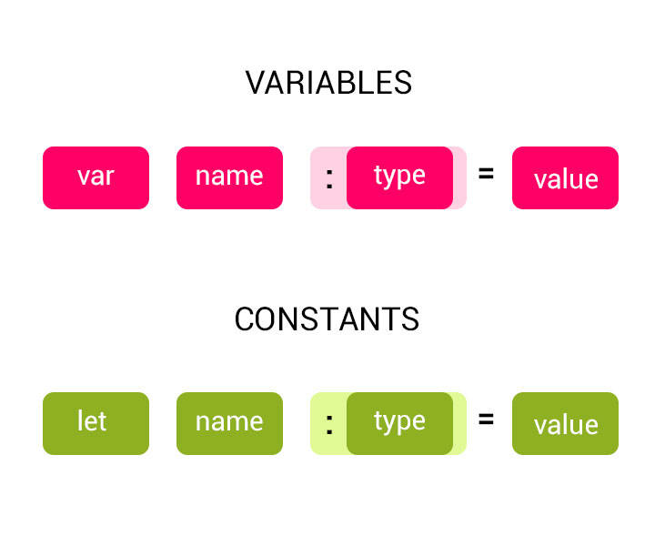

Slide 3
Variables and Constants
You can store values in variables and constants and that can be referenced by a name. The key difference is that a variable is mutable and a constant is immutable.
You should declare constants and variables before they can be used.
You can declare constants using the let keyword and variables using the var keyword.
Example:
let maxLoginAttempt = 3
var currentLoginAttempt = 0
Use constants for values that won’t change. Use variables for values that will change.

